Slide 1
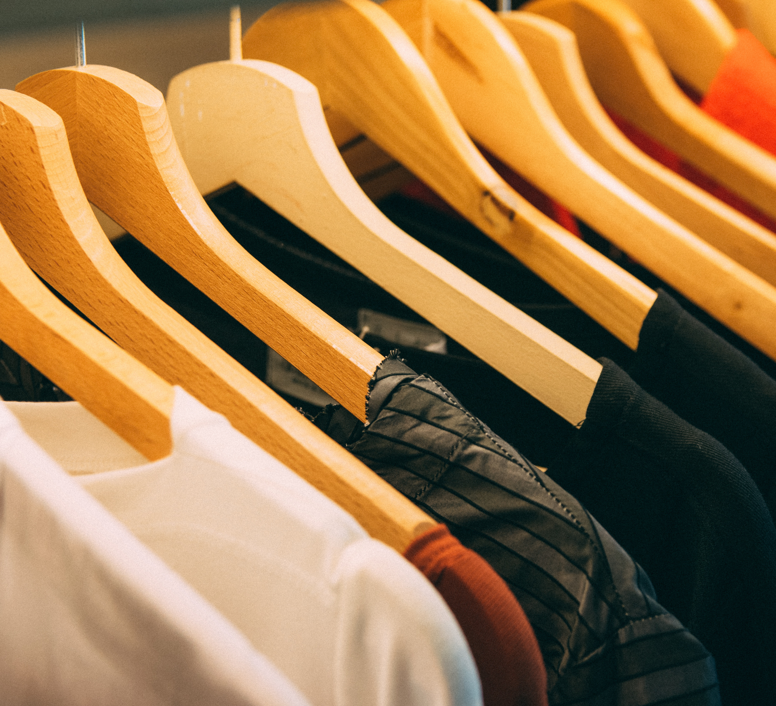
WeebO Wear
By:-
1. Binitdev Pandey
2. Adnan Shaikh
3. Kanchan Mengune
4. Zeeshan ansari
UNDER THE GUIDANCE OF
Prof. Rina Bora

Slide 2
Index
1. Introduction
2. Objective and Problem Statement
6. Conclusion and Future scope
3. System Design
7. Referances
6. Implementation and Results
5. Design Details
4. Requirements

Slide 3
Introduction
E-commerce is fast gaining ground as an accepted and used business paradigm.
It is reasonable to say that the process of shopping on the web is becoming common place.
The objective of this project is to develop a general-purpose e-commerce store where product like clothes can be bought from the comfort of home through the Internet.
The selected items may be collected in a shopping cart. At checkout time, the items in the shopping cart will be presented as an order.

Slide 4
Objectives and problem statement
Option to shop online.
Customers can view shirts, t-shirts and trousers from main page.
It will have cart in which you can store your favorite products from main page.
The products stored in cart can be purchased through check out page.
Homepage: Go to the brand website and shows all the products.
Shopping cart or add to list.
Select the product to be purchase.
Product section for admin so that he can add or remove products.

Slide 5
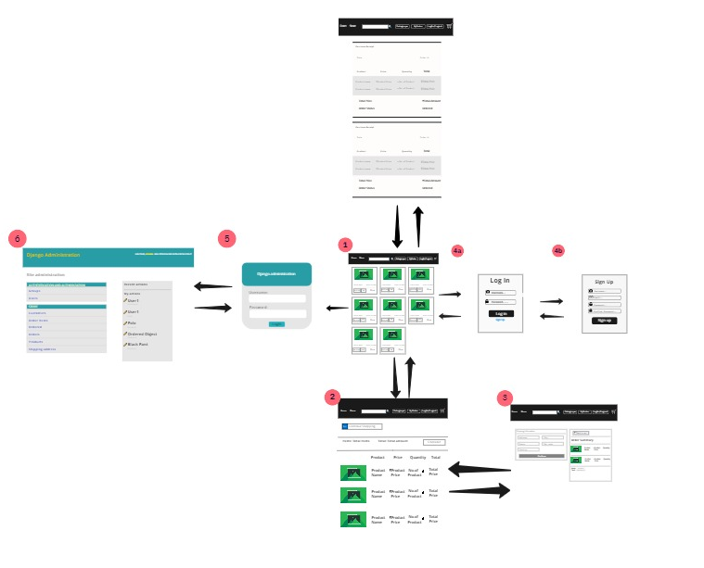
System design

Slide 6
requirements
HARDWARE REQUIREMENTS
RAM : 4 GB RAM
Hard Drive : 40 GB Hard Drive
Processor : Intel PENTIUM IV Processor
Camera module (Webcam)
Projector
Colour Marker
SOFTWARE REQUIREMENTS
PYTHON 3
DJANGO 3.1.7
VANILLA JAVA SCRIPT
HTML AND CSS
BOOTSTRAP 4

Slide 7
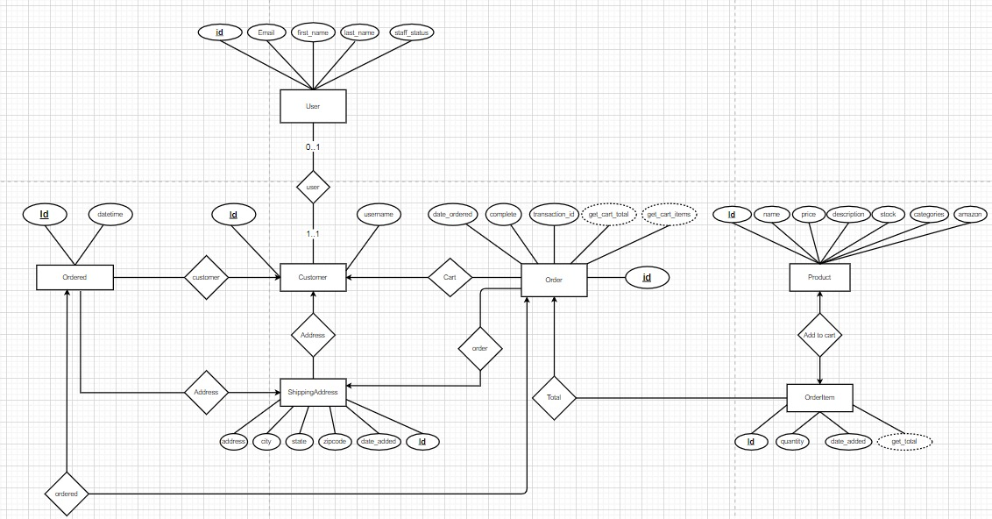
Design details
Design details

Slide 8
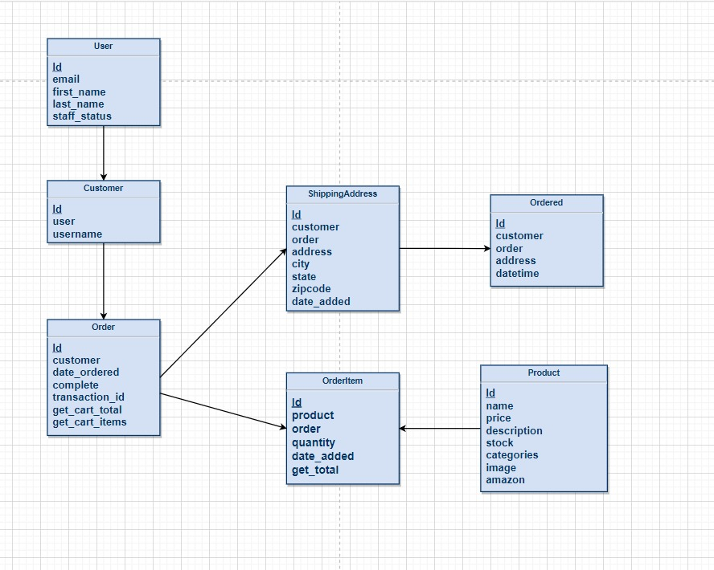
Relasional schema

Slide 9
Implementation and results
Login Page
Registration Page

Slide 10
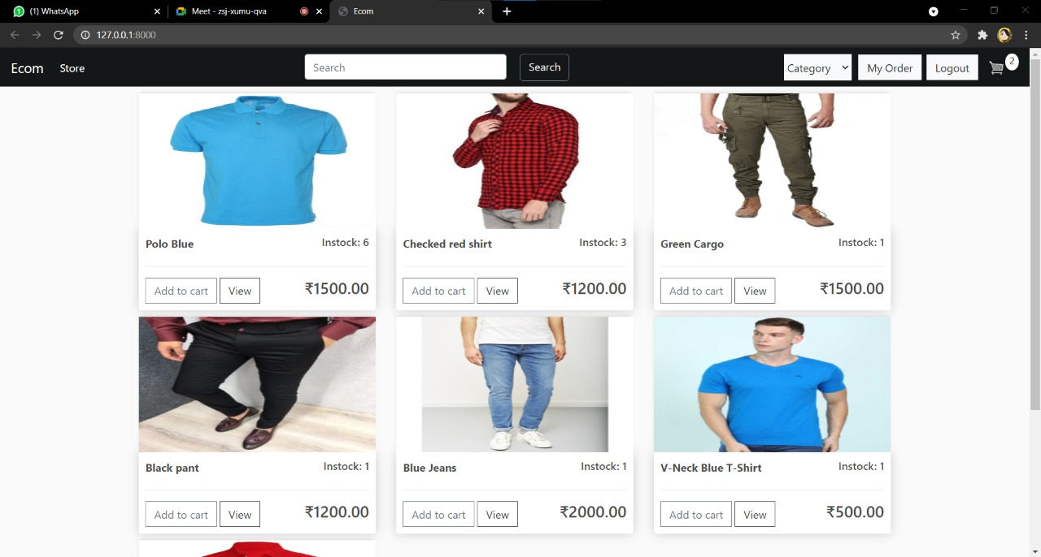
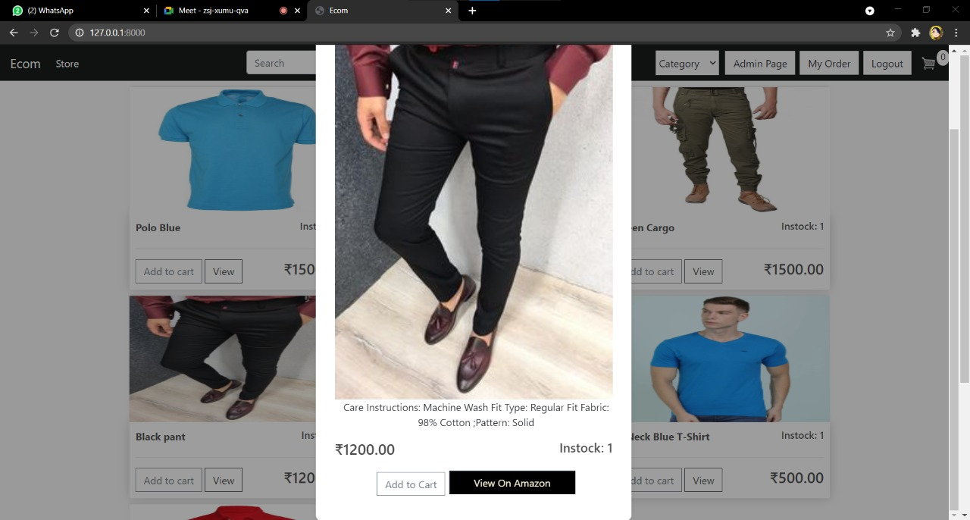
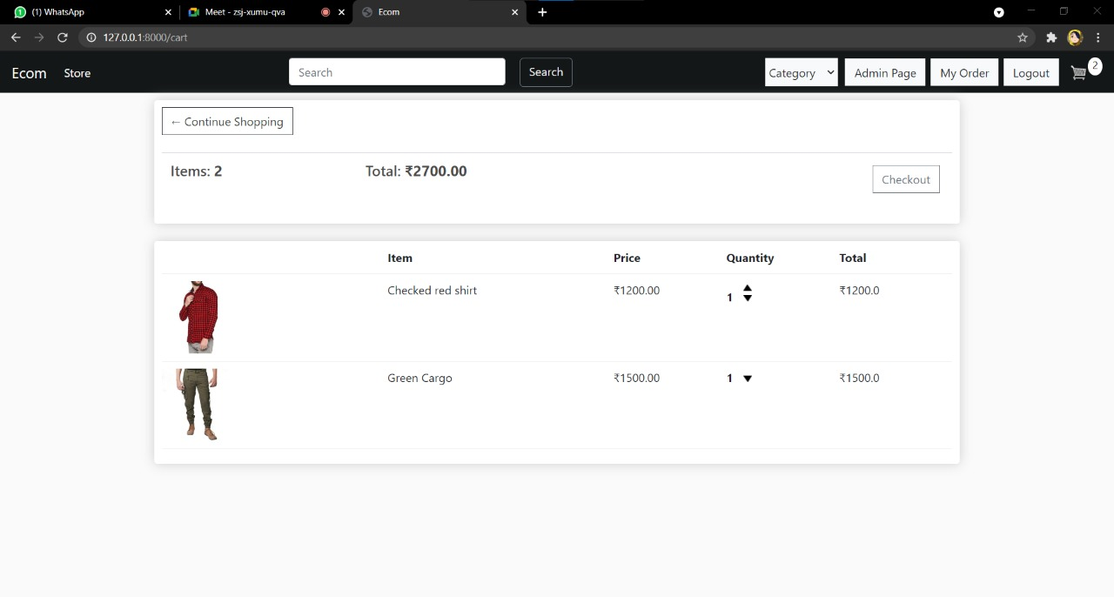
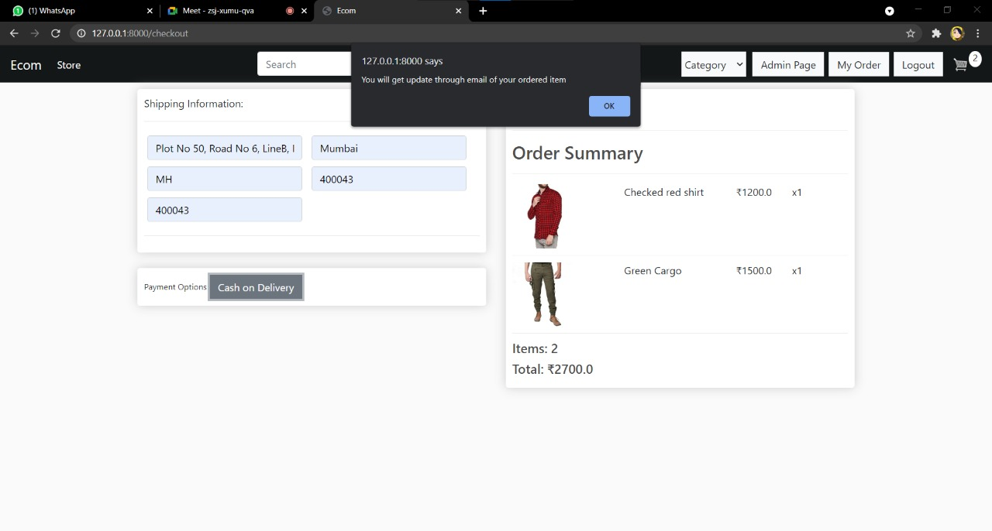
Home page
View PopUp
Add to cart
Checkout

Slide 11
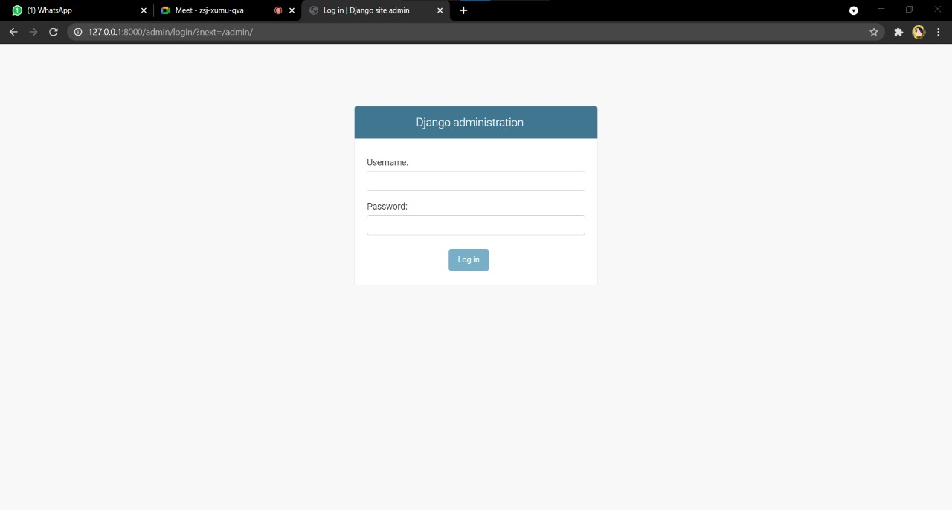
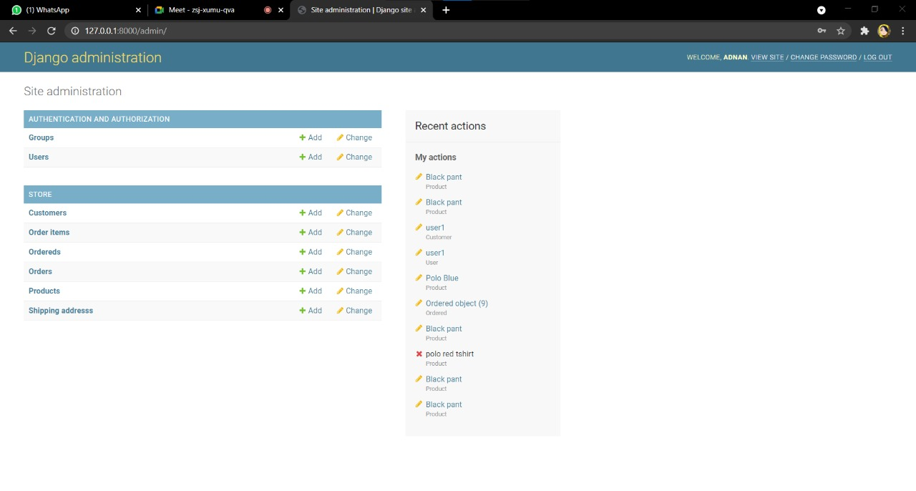
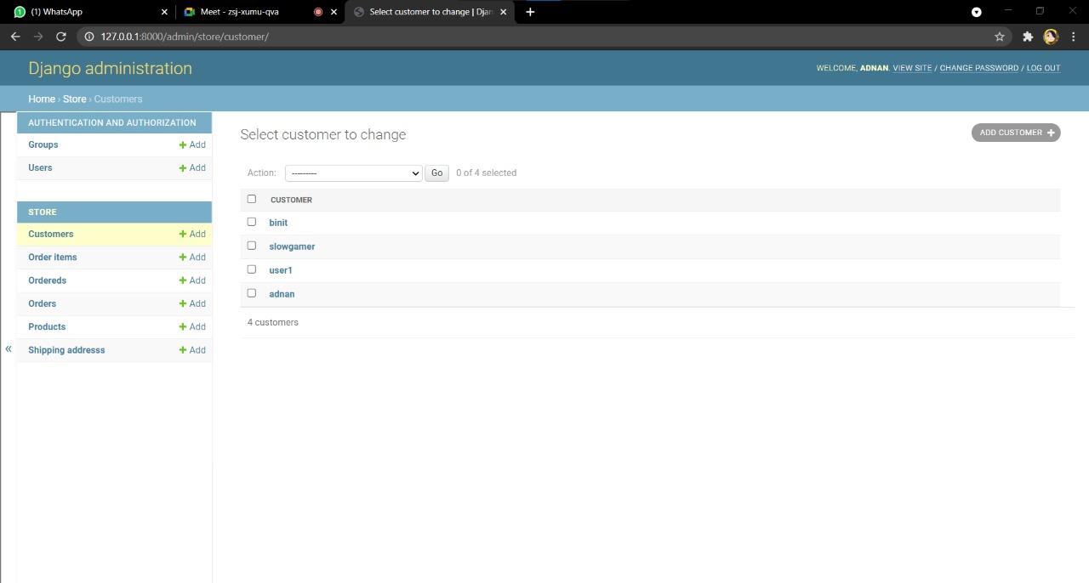
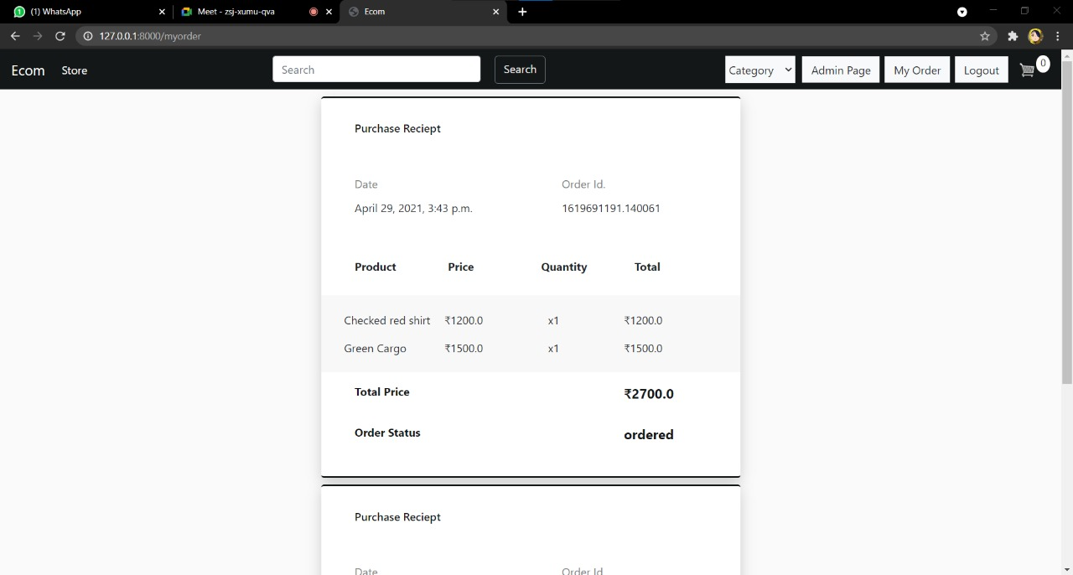
Admin login
Administration page
Store Page
Reciept

Slide 12
Conclusion and future scope
CONCLUSION:-
The ‘Online Shopping’ is designed to provide a web-based application that would make searching, viewing and selection of a product easier.
The user can then view the complete specification of each product. Viewer can become user by registering new account using sign up page and user can login through login page.
User can add its desired product to cart from cart page, it can increase or decrease the quantity of product, the products in a cart page can be purchase through checkout process easily.
User can check its order history in my order page Admin can login through Django administration page which will redirect it to Django administration home page where it can view and edit desired entities

Slide 13
Future Scope:-
We can add feedback feature for products.
We can add subscribe alerts for price drop and offers.
We can automate email functionalities which will ease our admin from email works.
We can enhance our project design using React library

Slide 14
references
https://docs.djangoproject.com/en/3.2/
https://codewithsteps.herokuapp.com https://getbootstrap.com/docs/5.0/gettingstarted/introduction/
https://app.diagrams.net/
https://miro.com/app/board/o9J_lHgpZ1s=/

Slide 15
Thank you

